Slide 1
16-BIT ADDITION
EXP NO: 5
AIM:To write an assembly language program to implement 16-bit addition using 8085 processor.
ALGORITHM:
1) Start the program by loading a register pair with address of 1st number. 2) Copy the data to another register pair. 3) Load the second number to the first register pair. 4) Add the two register pair contents. 5) Store the result in memory locations. 6) Terminate the program.
PROGRAM:
LHLD 2500 XCHG LHLD 2502 DAD D SHLD 2504 HLT

Slide 2
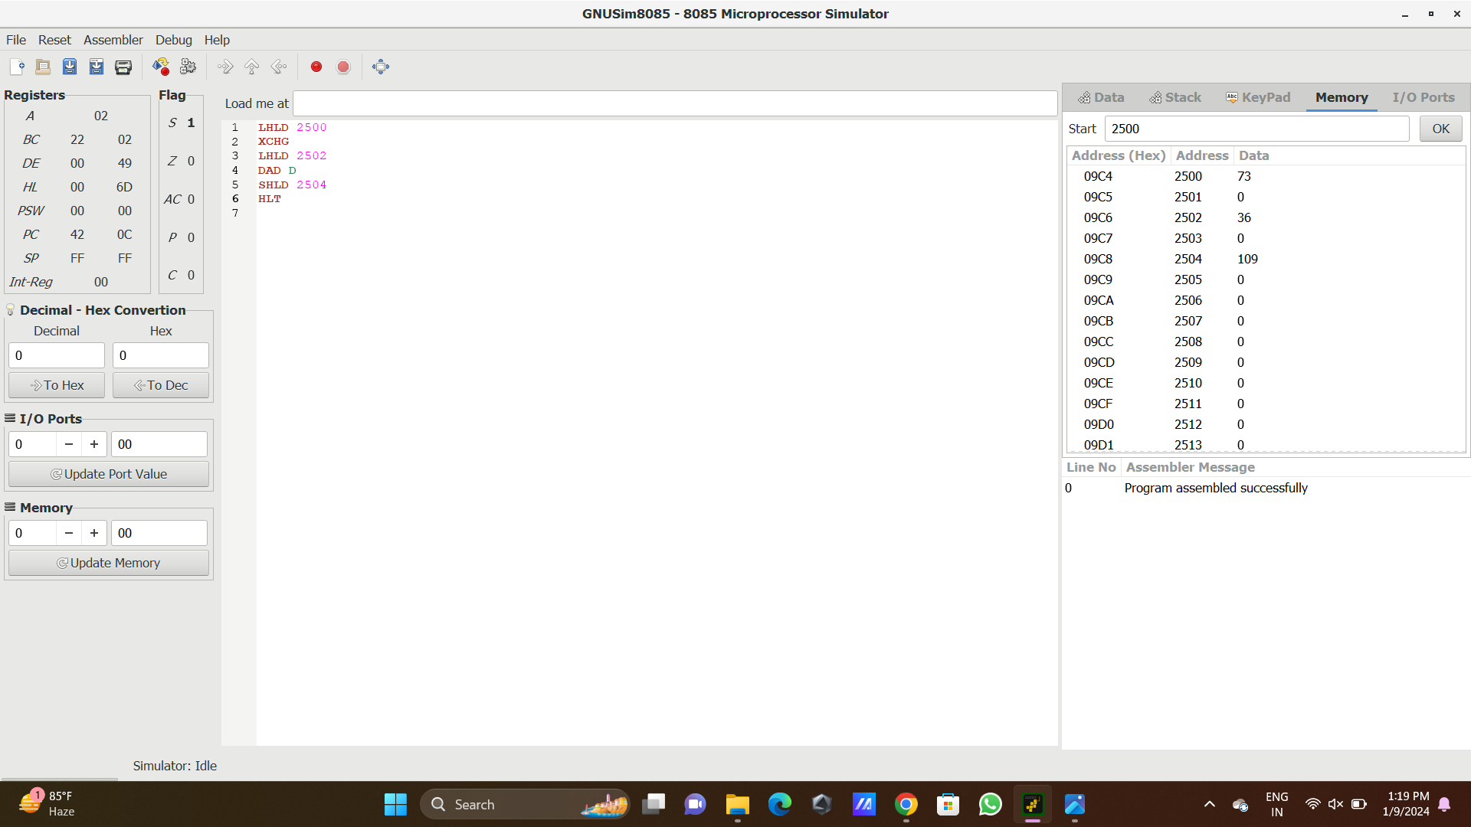
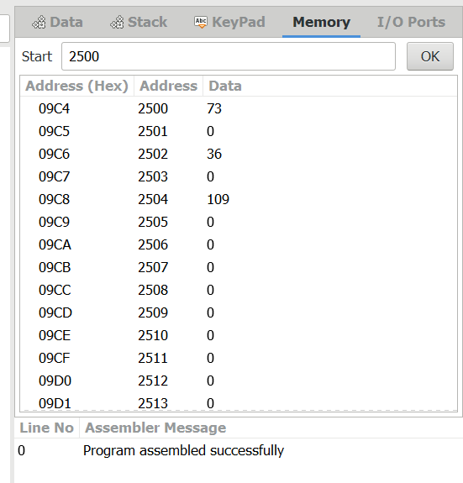
Input
Output

Slide 3
RESULT: Thus the program was executed successfully using 8085 processor simulator.

